Slide 1
Quinten Finance
Présentation offre
Octobre 2025

Slide 2
SMARTER DECISIONS – MEASURABLE RESULTS Powered by AI
STRICTLY CONFIDENTIAL
Quinten Services Capabilities
Octobre 2025

Slide 3
Agenda
OVERALL CAPABILITIES
SMARTER DECISIONS, MEASURABLE RESULTS
USE CASES

Slide 4
OVERALL CAPABILITIES

Slide 5

Business-Driven AI, Built for Impact
Tackle strategic business challenges with AI solutions that combine cutting-edge technologies and a deep dive into each industry.
Co-designed with clients and powered by high-performance in-house tools, our solutions accelerate implementation and drive measurable impact across growth, risk management, and customer intelligence.
STRICTLY CONFIDENTIAL
Notes:
Peut-on le reprendre de façon si similaire?

Slide 6
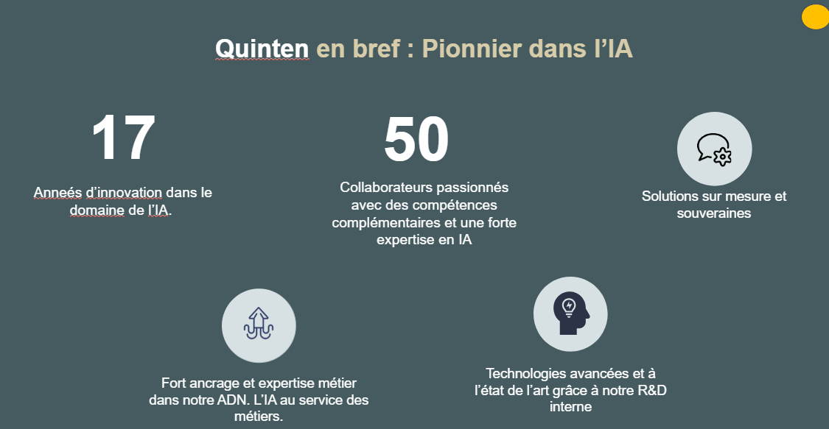

Slide 7



À traduire + titre et messages plus impactant
Artus (L) + Ghita
Quinten at a glance - Data & IA Pioneers
17
50
Passionate experts with complementary skills and deep, hands-on AI experience
Custom & Sovereign Solution
Tailor-made, secure, and sovereignty-ready from design to deployment
Years pushing the boundaries of AI
Built on Business Insight
Fort ancrage et expertise métier dans notre ADN. L’IA au service des métiers
State-of-the-Art Tech
Advanced methods powered by in-house R&D for solutions that are robust, scalable, and future-proof

Slide 8
La confiance des parties prenantes les plus exigeantes
Simon (L) + Thomas
Chez Quinten Finance, avons réalisé des dizaines de projets dans les domaines exigeants que sont la finance et le secteur public :
Traduire en anglais
Entreprises publiques :
Advanced modelling to turn complex data into actionnable insight (e.g. absenteeism issues in the public sector).
BPI & Ministères :
Corporate intelligence solution leveraging GenAI technologies to enhance existing tools and support strategic decision-making
Bank Industry :
100+ projects to drive impactful outcomes, combining tool-based consulting on risk, fraud, and marketing challenges.
Format pas top; ordre à changer?
Faire + apparaitre : domaine EXIGEANTS et stratégiques (ex: absentéisme ds le domaine publique = clé; fraude en banque = clé, dev de l’innovation = clé etc…)
+ industrialisation

Slide 9
SMARTER DECISIONS, MEASURABLE RESULTS

Slide 10
From Insight to Implementation: What We Deliver to Accelerate Decisions
Lexique plus « grip » plus mordant :
@Simon : en fait je la trouve relativement OK celle-ci mais preneur de ton avis du coup ☺
→ Insight-driven investigations, turning complexity into clarity through actionable recommendations aligned with regulatory and business constraints.
→ Purpose-built AI tools, designed for speed and impact on high-stakes topic. Can be industrialized and deployed on-premise
→ AI and data roadmaps, designed to turn strategic vision into actionable, measurable outcomes
Simon (L) + Augustin
Notes:
Qu’est ce que l’on propose comme livrables?

Slide 11


An integrated, context-adaptive consulting approach combining insights, tools, and transparency.
Artus (L) + Simon
Transparent, collaborative consulting built on explainable AI.
We believe collaboration and clarity drive better outcomes.
Tool-augmented consulting
Insight-driven consulting
for high-stakes decisions. We combine:
designed to speed up high-impact projects.
Our toolkit includes:
Rapid immersion in the client context
Iterative problem framing with stakeholder input
Continuous insight validation and adaptation
Deep collaboration with domain experts to produce clear, actionable conclusions.
Domain-specific Common Data for consistent, reusable datasets.
Proprietary algorithms for subgroup detection,scoring, and predictive insights
Ongoing GenAI R&D to enhance analysis capabilities and unlock new opportunities.
Notes:
Quelles sont nos méthodes de travail? Ou : Deep-Dive Consulting

Slide 12

Transparent, explainable-AI consulting that delivers measurable outcomes.
Artus (L) + Simon
We pair domain insight with ready-to-use tools to cut time-to-value and de-risk decisions.
Insight-driven consulting
for high-stakes decisions. We combine:
Tool-augmented consulting
designed to speed up high-impact projects.
Our toolkit includes:
Rapid immersion in your context and constraints.
Iterative problem framing with stakeholder input.
Continuous insight validation and adaptation
Deep collaboration with domain experts to produce clear, actionable conclusions.
Domain-specific Common Data, production-ready.
Proprietary algorithms for subgroup, detection, scoring, and prediction.
Ongoing GenAI R&D to unlock new use cases.
Notes:
Quelles sont nos méthodes de travail? Ou : Deep-Dive Consulting

Slide 13
We support our clients in transforming the way they make decisions, through four complementary levels of intervention — depending on their needs : Recommend, Understand, Predict or Assist decision making
Thomas (L) + Augustin
Revoir détails wording
Recommend –
Shape & define data opportunities
Understand —
Diagnose & make sense of complexity
Predict —
Anticipate & trigger the right actions
Assist —
Accelerate decision-making in real time
Identify AI use cases, define strategic roadmaps, and de-risk data initiatives.
Uncover and structure complex business phenomena using heterogeneous data to clarify root causes and measure impacts
Detect weak signals, generate forecasts, and uncover emerging risks or opportunities. Enable targeted, timely action before issues escalate.
Provide augmented intelligence, connected to real-time and external data, to support and enhance human reasoning
Ajouter des KPIs
Ajouter donnée
externe
Retail banks use cases identification
Insurance’s Data roadmap
HR absenteeism
Sales performance diagnostics
Marketing efficiency audit
Customer churn study
On-premise daily churn alerts
Workload forecasting over several period of time
Live Fraud Detection
Commercial recommandations
GenAI powered prospecting tool
Real-time business insights
Business-specific intelligent assistant
Prendre plus de hauteur : désafection; énergie nécessaire pour changer d’état, désengagement…
Examples
• AI roadmap • Strategic recommendations
• Data-driven diagnostics
• Remediation plan
• Risk and opportunity scores • Alerting systems • Action prioritization
• Custom AI assistant • Augmented search engine • Real-time recommendations
Deliverables
Notes:
Quel service on rend?

Slide 14
Strategic business challenges addressed with AI-powered solutions helping organizations make faster & smarter decisions
Impact nom filiale?
Mettre le bénéfice dans le nom (QuintenPasCher)
CustomerAI un peu limitant et trop proche de People: GrowthAI? (interne)
Augustin (L) + Thomas + Artus
TargetAI
PeopleAI
CustomerAI
RiskAI
Inorganic growth & market development
Example : Identify high-fit M&A or partnership opportunities
Workforce performance
Example : Uncover root causes of absenteeism and HR disengagement
Sales & marketing performance
Example : Predict churn, optimize offers, forecast demand
Risk & compliance
Example : Detect fraud, alert on business failure
Faire apparaitre les directions concernées
Notes:
A quelle problématique métier on s’attaque? TL : lister les directions ciblées

Slide 15
Strategic business challenges addressed with AI-powered solutions helping organizations make faster & smarter decisions
Augustin (L) + Thomas + Artus
Quinten Insight
Q-Hunter / Target AI
Q-Worker / Perform AI
Q-Booster / Predict AI
Q-Protector / Shield AI
External growth & market development
Prospection, Identify high-fit M&A or partnership opportunities
Workforce performance
Uncover & explain root causes of observed phenomena (ex: disengagement)
Process & Internal performance
Predict clients’ behavior, optimize targeting, forecast demand
Risk & compliance
Detect outliers and fraud, alert on business failure
Corp Development, Strategy, Commercial, Busines Dev, Purchasing Dept, Marketing, Financials, M&A
HR, Operationnals, Strategy, Financials
Marketing, Sales, CRM, CFO, Operationnals,
Risk, Fraud, Sales, CFO, Operationnals
Teams
Use Cases
Notes:
A quelle problématique métier on s’attaque? TL : lister les directions ciblées

Slide 16




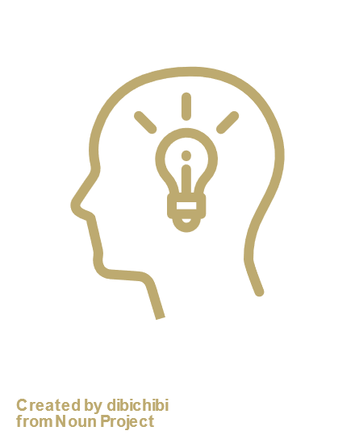

Our skills
Ghita (L) + Artus
S’inspirer de la slide QH : plus de détails, plus de différenciant !
GenAI
(LLM, RAG, NLP, OCR)
Data Science
(Supervised/Unsupervised ML)
« On a 5 d’avance techniquement » « du Poc à l’indus » etc… RAG / GenAI / Agentic ..
Industrialisation
MLOps, DevOps, UI/UX
Insight Specialist
Project Manager, Sector Experts
Visualisation
PowerBI, Tableaux
Notes:
Nos équipes / expertises

Slide 17
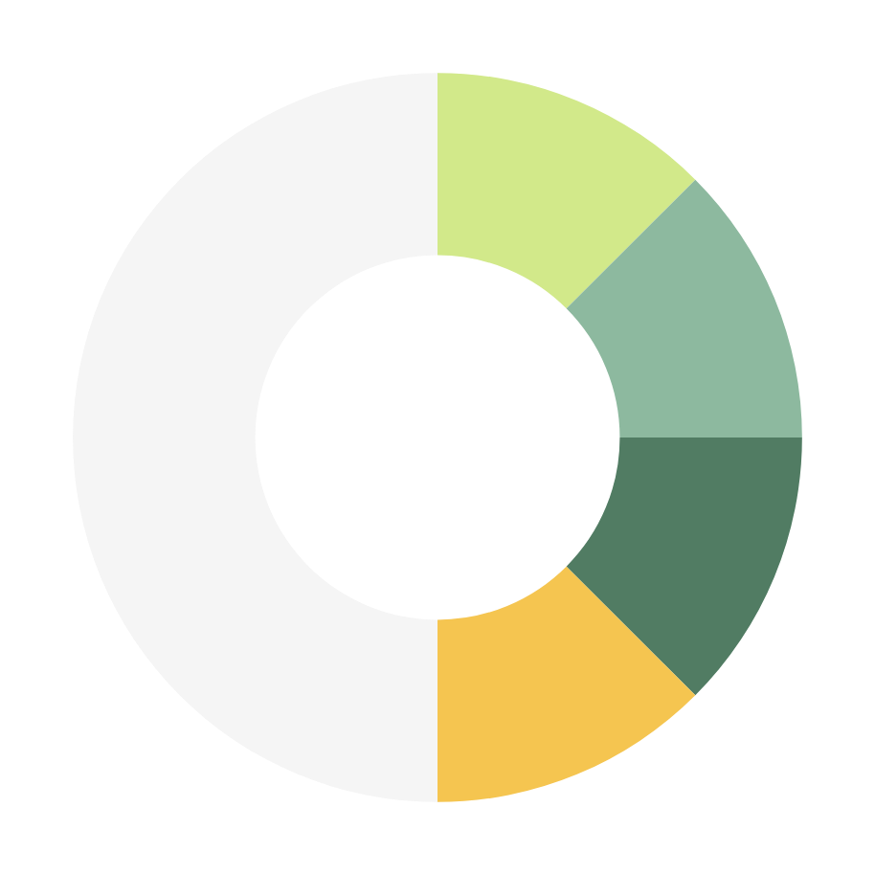


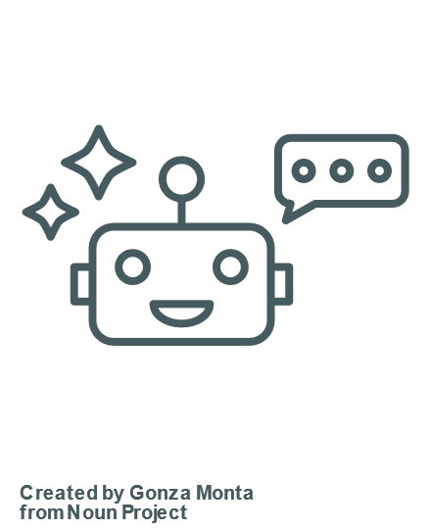




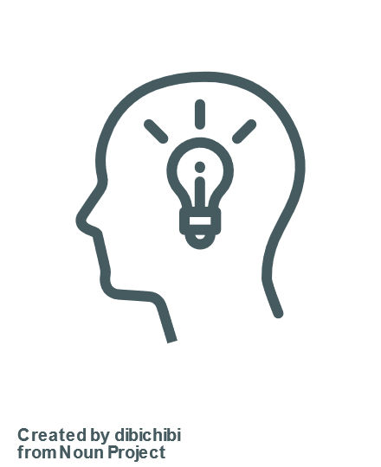
²
GenAI
At Quinten Finance, we build the bridge between innovation and execution.
Our teams combine advanced AI expertise with strong delivery capabilities to move from PoC to scalable solutions.
With a culture of technical excellence and agility, and
LLM, RAG, NLP, OCR, Agentic tools
Data Science
Supervised/Unsupervised ML
Our
Skills
a five-year lead in technological advance, we
Insight Specialist
Project Manager, Sector Expert
consistently deliver AI systems that last, perform, and create impact.
Industrialization
MLOps, DevOps, UI/UX

Slide 18


A Team of Highly Skilled AI/GenAI Pioneers and Healthcare Data Scientists
Project Managers & Consultants
Biomedical consultants
Data Analysts
Biostatisticians
Data Scientists GenAI experts
ML Engineers ML Ops
Quinten Health has consistently nurtured data science pioneers who are now leading data and AI strategies at the heart of pharmaceutical giants, healthcare disruptors, and global consultancies — actively shaping the future of real-world evidence, medical data platforms, and AI-driven innovation.
STRICTLY CONFIDENTIAL
Data engineers
Developers
KOLs
50+ healthcare passionate people with a set of complementary skills and expertise in RWD

Slide 19
Quinten en synergie avec l’éco-système Français
Simon + Artus (L)
Souverainté : OVH, Mistral, BPI,
Recrutement top écols d’ingénieurs FR + partenariat Essec, X/HEC (trop vieux?) , JDZ et le super-calculateur
Partenariat : Topics? Studia?

Slide 20




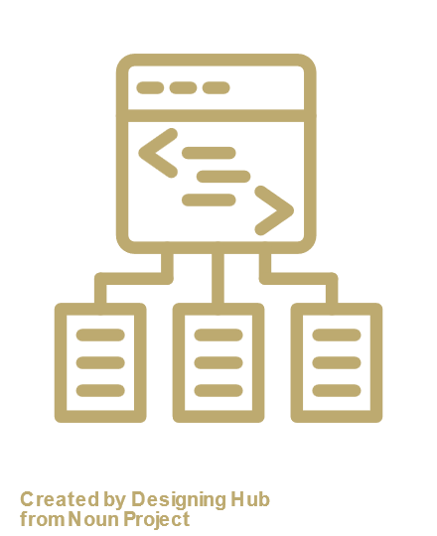




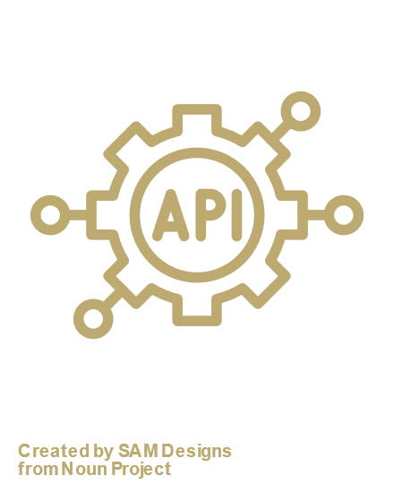
Augustin (L) + Simon
Our data expertise
Based on 17 years of experiences and more than 100 projects,we have the ability to work …
… with complex, high-volume data in constrained and regulated environments
… with external data
… on diverse environnements, with widespread platform and tools
Projects running on-premise for retail banks
Expertise in INSEE and INPI data
AWS, OVH, GCP
Monthly run over more 500gb data
Dataiku, Databricks
Process to collect and extract information from news
Prospection tool using sovereign models and infrastructure
Python, R, Spark, BigQuery
Identify, scrappe and structure information from websites
Mistral, OpenAI,
Anthropic, Gemini

Slide 21
Our achievements
Marketing targeting – Banking products
2.4× more sales than control targets (A/B testing)
30% higher processing rate by bank advisors
75% of sales made to first-time holders (vs 45% for control targets)
Check Fraud
Over 95% of check fraud detected
30% reduction in investigation time
0 service interruptions in 3 years of production
Absenteeism study – Public transport
8% reduction in absenteeism over 12 months, including 25% in certain job categories
Over 100 remediation levers identified across 8 departments
Workload forecast
Number of FTEs reduced by 10% on average, with no decrease in perceived quality
Time required to plan the annual budget reduced by 4×
Number of iterations and simulations far higher than the previous process
Prospection support – Public sector
Over 98% accuracy in linking companies to their websites
50% reduction in time required for prospecting
Twice as many companies identified on average as relevant

Slide 22
USE CASES

Slide 23
Liste des use case d’intérêt
Use case | Description | Service | Challenge
SATT |  | Assist | Target
Altares |  | Assist | Risk
IMA |  | Predict | Customer
Fraude |  | Predict | Risk
BRED |  | Understand | Customer
CERA |  | Predict | Customer
RATP |  | Understand | People
Kélio |  | Assist | People
Augustin à finir
Augustin
Augustin
Simon
Thomas Fraude Interne ?
Ghita
Augustin (x2 ?)
Thomas + Artus
Ghita

Slide 24
Identify companies’ website with high degree of certainty
Template Use Case 1
Objectives & challenges
Method
Key results & Impact
Identify with high degree of certainty the website of a company, based on its name and public information
Detailed and transparent decisions
Efficient at an international scale
High degree of certainty, with specific labels for multiple candidats or uncertain cases
Highly configurable codebase
Use state-of-the-art LLMs and fast scrapping technologies to collect the key informations
1- Look for the company via SERP (Search Engine Result Pages), located on the company’s country
2- Scrap the main page and use Regex to minimize the content to structure
3- Use an LLM, and regex methods to structure the content and extract the key information
4- Use all the information available to make the best decision, using strict rules for validation
Improves the reliability of company–URL matching to over 98% when established
More than 700,000 company–URL links generated
Ability to generate 30,000 new links per day at a cost of less than €0.01 per link
Mettre des GRAPHS ou IMAGES

Slide 25
Collect intelligent and structured information from any company’s website
Template Use Case 1
Objectives & challenges
Method
Key results & Impact
Construct an API that has the ability to answer any question from a website if the information is available.
Minimise the cost and the number of - explored pages
Adapt automatically to different structure
Scale to thousands of website explored each day
Store the result in a structure database
Use state-of-the-art Agentic LLMs and fast scrapping technologies
1- Use agentic functionalities to allow the LLM to choose the subpages to explore
2- Use Regex to minimize the content to structure and extract information
3- Use external LLM to structure the information
4- Store the information for later exploitation
700,000+ company websites structured and ready for analysis or integration
Ability to answer any questions if the answer is available on the website
Creation of a unique, unmatched company knowledge base
Mettre des GRAPHS ou IMAGES

Slide 26
Sovereign solution to ease prospection in the French public innovation ecosystem
Template Use Case 1
Objectives & challenges
Method
Key results & Impact
Build and deploy a tool for Business Developers to identify and qualify French companies most likely to incubate a technology
Use collected knowledge of French companies’ activities
Understand and leverage the concepts included in a technology description
Accelerate the Business Developers’ workflow
Use state-of-the-art LLMs and storage to maximise understanding of the user’s prompt
1- Break down the user’s prompt
2- Use SOLR to retrieve the most relevant candidates efficiently
3- Rerank the candidates using all available information, including financial and innovation KPIs
Reduced time for prospection by a factor 2
50% additionnal prospects identified
TBC..
Mettre des GRAPHS ou IMAGES

Slide 27



Notre positionnement chez Quinten Finance : Une IA souveraine et innovante façonnée par et pour les métiers
A traduire, et à relire
Leader en IA
Expertise métier et conseil
Solutions personnalisées
Souveraineté
Dizaines de solutions IA et GenAI en productions utilisées par nos clients
Datalab interne et veille technologique permanente
Plusieurs actifs différenciants (analyse des signaux faibles, base spécifique entreprises, moteur de matching, etc.)
Expertise dans la donnée d’entreprise et bancaire
Intervention sur l’ensemble de chaine : du cadrage à l’utilisation par les équipes
Refonte des processus, montée en compétence, appropriation par les équipes
Outils co-construits avec nos clients et les métiers en production et utilisées
Dérivation des modules Quinten en fonctionnalités sur mesure
Interface utilisateurs adaptée à votre workflow
Maitrise des données et des traitements (France)
Non-dépendance aux modèles en ligne
Conformité RGPD & évitement du Cloud Act
Notes:
RECAP

Slide 29

Real-Time Signals for Business Failure Risk Detection
Challenge
Poor assessment of company health and compromised high-stakes decisions due to outdated data.
Existing tool unused due to excessive false positives and lack of trust
Abrupt score changes led to confusion and high customer support volume.
Data & Method
Ingested real-time signals from hot data sources (e.g., press articles).
Developed advanced NER and entity matching to link companies to the correct SIREN
Built machine learning models to assess risk level
Delivered a SaaS platform with daily alerts for high-risk companies.
Results
Achieved >85% entity matching accuracy.
12x reduction in false positives vs. previous risk model.
Risk scores now evolve gradually, enabling earlier, smoother client communication.
Business Impact
Provided clients with timely, reliable, and actionable risk insights.
Drastically reduced support calls linked to misunderstood score changes.
Strengthened Altares’ market position as a leader in real-time data intelligence.
Protected brand trust by preventing reputational damage from outdated alerts.
STRICTLY CONFIDENTIAL
All use cases are part of Quinten’s expertise & track record

Slide 30
Use Case: Increase technology transfer through an AI-powered matching tool
Challenge
Matching a public research technology with the right company was time-consuming and manual.
Incomplete prospecting processus leading to missed opportunities due to national activity databases poorly structured,.
Assessing a company’s appetite for innovation was subjective and lacked standardized indicators.
Many high-potential tech transfers never reached the right industrial players.
Data & Method
Developed a semantic matching engine using LLMs and embeddings.
Matched technologies with companies based on detailed web content — not outdated classification codes.
Built innovation-readiness scoring based on structured and unstructured data (R&D departments, patents, publications, innovation grants, etc.)
Delivered a user-friendly platform ranking companies by both relevance and innovation potential.
Results and business impact
Empowered business developers with a high-precision, time-saving tool.
Enabled faster, smarter, and more exhaustive prospecting.
Standardized innovation scoring enhanced decision-making across SATT teams.
Identified highly relevant companies that were previously missed by existing tools.
STRICTLY CONFIDENTIAL
All use cases are part of Quinten’s expertise & track record

Slide 31
QH's Expertise in RWE & AI: Generate RW-based Solutions by Engaging with Stakeholders
Quinten therapeutic challenges
Track Record
Rare Diseases and Immuno-inflammation: Delivering advanced evidence generation to support research and development, market access and Life cycle management.
Oncology, with Rare Mutations: Anticipating and securing regulatory-grade indirect comparisons.
Cardiovascular and metabolic conditions, including obesity.
Complex Patient Journeys: Mapping intricate healthcare pathways to optimize outcomes for patients and providers.
500+ projects for 100+ organizations across the healthcare system.
Knowledge extraction from 100+ real-world databases & 100+ RCTs.
STRICTLY CONFIDENTIAL
Develop Disruptive RW-based AI-driven solutions
QH: Quinten Health, RWE: Real-World Evidence, AI: Artificial Intelligence, RCT: Randomised Controlled Trial

Slide 32
Trusted by the Most Demanding Stakeholders
We are proud to collaborate with leading healthcare stakeholders, institutions, and regulatory authorities.
AI-Native player with 15+-year existence, tackling some of the most pressing therapeutic challenges for:
Healthcare Industry – Delivering over 500 projects across 100+ organizations to drive impactful outcomes.
Cosmetic & fragrance Industry – Collaborating by turning complex data into actionable insights.
European Medicines Agency (EMA) – Contributing to regulatory-grade projects that meet the highest scientific and compliance standards.
Critical Path Institute – Partnering on cutting-edge initiatives to advance scientific and regulatory innovation through trusted nonprofit collaboration (e.g., disease modeling,…).
Swissmedic – Collaborating with Switzerland’s Agency for Therapeutic Products to develop disruptive GenAI-powered agents.
Banque Publique d’Investissement (BPI) and Ministries – Supported by France’s public investment bank in initiatives related to corporate intelligence and strategic matchmaking, supported health ministries in EU to upgrade their quantitative decision support tools (e.g. for COVID).
STRICTLY CONFIDENTIAL

Slide 33


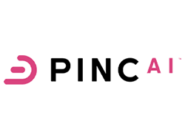








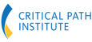


Quinten’s Innovation Ecosystem is Redefining RWE
By uniting deep domain expertise, cutting-edge technology, and a track record of regulatory rigor, Quinten Health is uniquely positioned to accelerate next-generation evidence generation while remaining firmly anchored in regulatory science.
Strategic alliances with Premier Real-World Data Providers unlock economically sustainable data-utilization models and power impactful translational research and medicine.
Working in close partnership with Regulatory Authorities to ensure every RWE breakthrough meets the highest standards of scientific and regulatory soundness.
Innovative
RWD Partnerships
Collaborating with Forward-Thinking Partners to amplify impact and build awareness of novel real-world evidence and RCT-enhancement approaches.
STRICTLY CONFIDENTIAL
Regulatory
Science
&
MIDD
Digital twins
& Predictive
medicine
¹
Digital Biomarkers
& Worldwide compliance
Ad Scientiam and MyDataTrust - our Sister Companies - drive breakthrough remote patient-monitoring analytics and guarantee regulatory-compliant scale-up worldwide.
RWE: Real World Evidence
¹: IRD -UMMISCO

Slide 34
A Team of Highly Skilled AI/GenAI Pioneers and Healthcare Data Scientists
Project Managers & Consultants
Biomedical consultants
Data Analysts
Biostatisticians
Data Scientists GenAI experts
ML Engineers ML Ops
Quinten Health has consistently nurtured data science pioneers who are now leading data and AI strategies at the heart of pharmaceutical giants, healthcare disruptors, and global consultancies — actively shaping the future of real-world evidence, medical data platforms, and AI-driven innovation.
STRICTLY CONFIDENTIAL
Data engineers
Developers
KOLs
50+ healthcare passionate people with a set of complementary skills and expertise in RWD

Slide 35

QH’s Technical Assets: 4 Domains
Our technical assets are structured across 4 main domains. Each domain contains our differentiating and proprietary technical assets developed in-house, in addition to the usual techniques mastered by our teams
DISEASE & CARE MODELING
Predictive ML modeling w. or wo. Intepretability layer
Qfinder: to generate and select subpopulations with significant signal
Qluster: generic workflow for robust clustering
Advanced sequence analysis
Causal inference
Biomedical knowledge graphs
Bayesian networks
SIMULATION & SYNTHETIC DATA GENERATION
Survival analysis, Bayesian statistics, probabilistic models, deep generative AI
SDG with GANs/VAEs/Bayesian networks/Copulas
Synthetic Survival Data Generator
LLM-Based Synthetic Patient Data Engine
Synthetic Data Evaluation Framework​
STRICTLY CONFIDENTIAL
NLP & LLM POWERED TASK AUTOMATION
Classic NLP frameworks, Transformers, LLMs, Retrieval Augmented Generation (RAG)
ALIBERT – a suite of model for French biomedical language
Oncodyssee: A pipeline to process and structure oncological patient reports
Q-SLR​ : AI-based systematic literature process in medical field​
HEALTHCARE & REAL WORLD DATA INTEGRATION
Data engineering​, Data audit​, Data vizualisation​
OMOP transformer
STabDesc : automated system for descriptive statistics
Sequence visualization​ : lbox to visualize sequence according to the focus of interest

Slide 36

Quinten Health Innovation Engine
INNOVATION ACCELERATORS
Business-Driven R&D:
As technology is constantly evolving, QH aims to keep innovation at the heart of its activities. R&D work is business-oriented and dedicated to the development of our 4 main domains
20% of our operational time is dedicated to R&D
Academic & Research Partnerships​ : Close collaborations with methodologists in leading institutes (See slide: Quinten’s Innovation Ecosystem is redefining RWE)
INNOVATION CULTURE
Scientific Monitoring & Knowledge Sharing: Weekly “insight sessions” to review key publications and discuss actionable takeaways.
Skills Development: Ongoing internal and external trainings keep our teams at the cutting edge.
Talent Sourcing & Onboarding: Robust network spanning private sector and academic labs, coupled with an immersive onboarding program that fosters autonomy, teamwork and excellence.
STRICTLY CONFIDENTIAL
INNOVATION OUTPUTS
R&D-Embedded Deliverables: the vast majority of our client engagements include an R&D component, ensuring continuous capability enhancement.
Scientific dissemination: Regular publications and conference presentations showcase our advances in disease modeling, real-world evidence and AI applications.
(See slide: Sample of recent publications on Disease & Care Modeling & Simulation)
QH: Quinten Health

Slide 37

Quinten’s commitments towards Health Data & Security
Quinten Health implements a rigorous information security management policy, based on a structured governance system, certified best practices, and a secure data processing workflow — from initial collection to final deletion.
ISO Certification & Information Security Policy (ISMS)
Certified ISO/IEC 27001 for the past 4 years.
The Information Security Management System (ISMS) applies contractually to all employees and subcontractors.
Health data are subject to a strict contractual framework because of the interest in protecting the privacy of private individuals.
As such, processing health data is an exception to the prohibition principle allowing the processing of their personal and medical information.
Having operated in the field of Real-World data for years, Quinten is strongly committed towards data security, as evidenced by its ISO 27001 certification obtained after a thorough process.
Simplification of Regulatory Procedures
Quinten Health has solid experience in regulatory submissions for Real-World Data (RWD) studies, and holds a CNIL MR-004 compliance attestation, confirming adherence to French data protection requirements.
Secure Data Hosting
Healthcare Data are hosted on HDS (Health Data Hosting) - Certified Servers.
When sovereign hosting is required, data is hosted on a secure platform operated by OVH, meeting high standards for both physical and logical security.
Legal Oversight
Legal compliance is overseen by a Data Protection Officer (DPO) (law firm).
Internal DPO liaisons are designated across project teams.
A regulatory watch is continuously maintained, and DPO consultation is mandatory for any new project or change involving personal data.

Slide 38










Managing, Securing & leveraging Healthcare Data
Procedures Covering the Full Data Lifecycle
Privacy by Design: Regulatory compliance is integrated from the project design phase.
Processing Register: Mandatory registration for any project involving personal data.
Incident Management Process: Formal procedures for detection, reporting, and resolution of data incidents.
Quarterly audits of hosting servers to verify retention periods and compliance with stated purposes.
Mandatory GDPR and information security awareness training for all employees
Technical Security Measures
Confidential data must be encrypted during storage and sharing, and only authorized individuals approved by the project manager can access it (need-to-know and need-to-use principle). All data is backed up and versioned.
In terms of security, access to data must be through company-managed and secured hardware. To ensure this, we apply conditional access, monitor hardware, and use, where technically possible and necessary, MFA, IP filtering, VPN access, network segmentation and firewalls.
GDPR compliant by design
Data processing agreement
Privacy Impact Assessment (PIA)
Compliance audits & internal controls
Exclusive Data Protection Officer Support
Data processing register
High infrastructure security
Security measures
Staff training on GDPR
GDPR rooted in Quinten’s processes and projects
Contractual framework
Guaranteed reasoned use of data
Active self-control
Responsible for compliance with GDPR requirements
Transparency
Cybersecurity
Measures against data breach
Technical and organic protection

Slide 39


Quinten & Sovereign Technologies
Cap Digital: Quinten is a winner of the Hyper Open X call for projects — aimed at spreading locally developed cloud/edge tech within the French digital ecosystem, especially SMEs and startups. Operated by Cap Digital and Bpifrance as part of the France 2030 plan.
We have also developed a deep expertise in sovereign technologies and regulatory-grade AI applications, involving Large Language Models (LLMs).
STRICTLY CONFIDENTIAL
QH: Quinten Health

Slide 40
Quinten & Quinten Finance
Notre offre
Exemples de projets
Sommaire

Slide 41

We support our clients in transforming the way they make decisions, through three complementary levels of intervention — depending on their needs for understanding, prediction, or augmented thinking
Understand —
Diagnose & make sense of complexity
Predict —
Anticipate & trigger the right actions
Augment —
Assist decision-making in real time
Uncover and structure complex business phenomena using available data. Clarify root causes, measure impacts, and shape actionable strategies.
Detect weak signals, generate forecasts, and uncover emerging risks or opportunities. Enable targeted, timely action before issues escalate.
Provide augmented intelligence, connected to real-time data, to support human reasoning. The system doesn’t just predict — it thinks with you.
HR absenteeism
Sales performance diagnostics
Churn alerts
Workload forecasting
GenAI powered prospecting tool
Real-time business insights
Marketing efficiency audit
Customer churn study
Fraud detection
Commercial recommandations
Business-specific intelligent assistant
• Data-driven diagnostics • AI roadmap • Strategic recommendations
• Risk and opportunity scores • Alerting systems • Action prioritization
• Custom AI assistant • Augmented search engine • Real-time recommendations
Deliverables
Deliverables
Deliverables

Slide 42
Accelerating Business Decisions with Tailored AI and Expertise
Qu’est-ce que l’on fourni? - Analyse - Produit Industrialisé (on premise)
→ Purpose-built AI tools, designed for speed and impact on high-stakes topics like growth and business risk
→ Augmented consulting, to guide decisions on complex or sensitive issues such as commercial performance and workforce dynamics
Slide d’après : méthode « augmented consulting » à étayer un peu plus + conseil outillé

